Slide 1
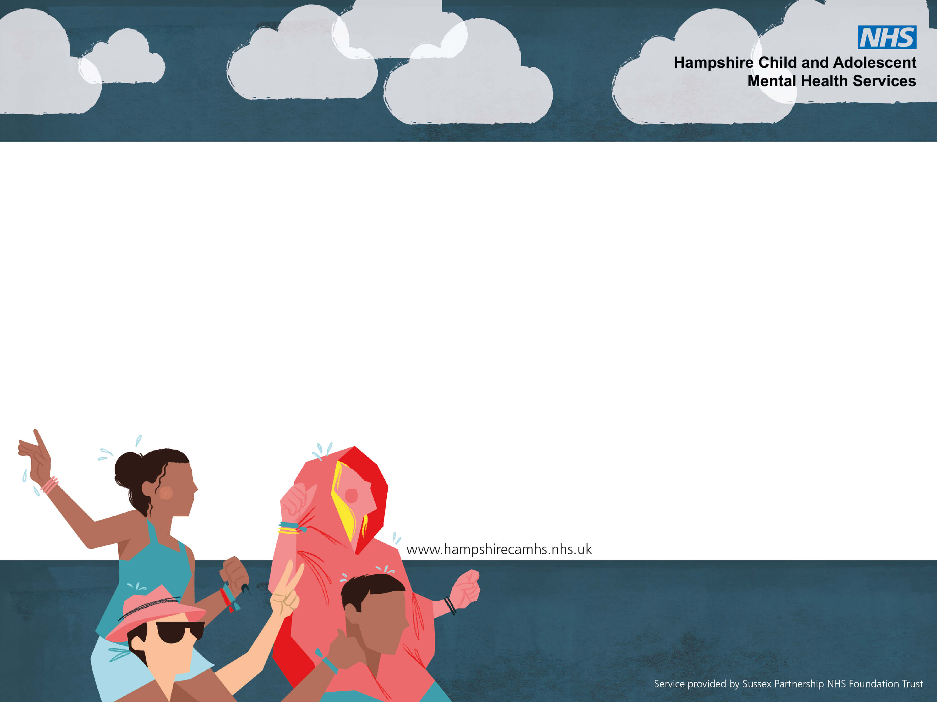
How to support a young person who may have autism.
Dr Catherine Robson - Clinical Psychologist

Slide 2
National Autistic Society
www.autism.org.uk
Autism Hampshire
www.autismhampshire.org.uk
Barnados Specialist Parenting Support
Hampshire Specialist Parenting Support Service | Barnardo’s
Ask About Autism – BRAAIN/HPCN
https://www.braain.co.uk/ask-about-autism.
Notes:
Because this presentation is brief – please use these as a source of further information.

Slide 3
What is Autism?
Difficulty with understanding others – what other people think, feel, do and why; other people having difficulty understanding them
Differences in how they communicate and understand others’ communication; other people having difficulty understanding their communication – language, behaviour, facial expression, gesture
Difficulty understanding social rules and situations
Difficulty imagining things - things that haven’t happened yet, the future, something that they haven’t experienced
Difficulty understanding relationships and how they function
Sensory sensitivities and preferences
Fixed ways of thinking and behaving; dislike of change.
Special interests
Notes:
This can look like:
Having difficulty making or keeping friends, not “getting” the social context, copying others, feeling overwhelmed by social demands, not understanding how others think and feel (theory of mind), noticing objects and facts rather than thoughts, feelings and intentions.
Can be under, or over, sensitive to others’ moods d emotions.
Understanding the right things to say at the right time, the use of non-verbal communication (gestures, eye contact), communication about their own or others emotions
Imagination – fixed interests, thinking about possibilities, planning, generalising
Fixed ways of doing things – could be interests, behaviours etc.
Can lead to a constant state of alertness and anxiety

Slide 4
What Autism might look like
Difficulties/Differences in:
Friendships – making, keeping, understanding
Understanding the social context”, overwhelmed by social demands, not understanding social rules
Unusual ways of talking or communicating; Difficulty listening, taking turns, having conversations; differences in use of non-verbal communication e.g. gesture, facial expression
Understanding what people mean and what people’s motivations are; not understanding how others think and feel.
Understanding and communicating about emotions
Imagination - predicting what is going to happen, what could happen, what the options are; the future
Unusual, intense or excessive interests
Fixed routines and ways of doing things; “my way”
Sensory interests or sensitivities – noises, lighting, feelings of clothes, busy places
Notes:
This can look like:
Having difficulty making or keeping friends, not “getting” the social context, copying others, feeling overwhelmed by social demands, not understanding how others think and feel (theory of mind), noticing objects and facts rather than thoughts, feelings and intentions.
Can be under, or over, sensitive to others’ moods d emotions.
Understanding the right things to say at the right time, the use of non-verbal communication (gestures, eye contact), communication about their own or others emotions
Imagination – fixed interests, thinking about possibilities, planning, generalising
Fixed ways of doing things – could be interests, behaviours etc.
Can lead to a constant state of alertness and anxiety

Slide 5
We use DSM-5 criteria
Diagnostic category is Autistic Spectrum Disorder (ASD) but we usually refer to Autistic Spectrum Condition (ASC)– they are the same.
(No longer have Asperger’s Syndrome as a diagnosis – but look up the literature! Lots of good books that are about Asperger’s)
Notes:
Figures from the US in 2018 estimates nearly 1 in 59 children – between 1 and 2 % (1.7%)
Estimates nearly 70% DO NOT have LD
35% of siblings will also have autism
Used to think that ratio of boys:girls was 4:1 but think now its about 2:1

Slide 6
Need differences in all areas – significant and impactful
Social communication / interaction:
Social reciprocity
Non-verbal communication
Relationships
Restricted / repetitive behaviour:
Repetitive speech/behaviour
Insistence on sameness
Restricted interests
Sensory aspects
Not every child who shows some difficulties will be autistic
But……
For some autistic children the difficulties won’t be obvious to everyone.

Slide 7
We should aim for Autistic children and adults to be proud and happy with who they are.
Aim is not to change the child. Aim is understand how they might experience things differently and what might help them.

Slide 8
A diagnosis can help people become aware of, and make plans for, both their qualities and difficulties.
However, diagnosis does not change the child or the difficulties or strengths.
There is no “treatment” for autism.
Aim for neurodiversity inclusive practices regardless of diagnosis.
Look at presenting needs - Work with what you see; work with what the child says.
Adjust what you do to support the needs of the child

Slide 9
Legislation
Reasonable adjustments
Autism Act
Equality Act
Education Act
All mention the duty to implement ‘Reasonable Adjustments’ so that those with a disability are not disadvantaged in a variety of settings from education to employment.
Autism is a ‘hidden’ disability and so the duty is often not fulfilled .

Slide 10
How to help
Autism + Environment = Outcomes
Luke Beardon
Ask the question why? Look through the Autistic Lens

Slide 11
Communication
Clear and unambiguous
Concrete, not abstract
Make sure the words match the tone, facial expression, gesture.
Short, one instruction at a time
Tell them what to do, not what not to do
Use visual means to support – whatever their ability
Use concrete props
Allow time for processing
Try - Books and facts, Scientific language/metaphors

Slide 12
Increase predictability and routine
Coping with change involves imagination
Change= unpredictable=scary
Use visual timetables (calendars, diaries…)
Daily routine when can look at timetable and plan for changes
Use little normal routines to add security e.g. what happens at mealtimes, bedtimes
If something changes, let them know. ?daily check in at school
Plan and prepare – visit, look at pictures, plan coping strategies.
Talk through what they can expect in new situations.
Keep a notebook with answers to questions – refer back
Use timers and countdowns
Plan for “waiting” – unstructured time can be overwhelming

Slide 13
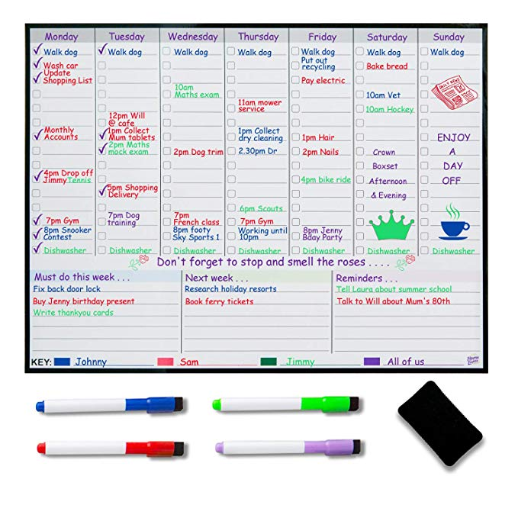
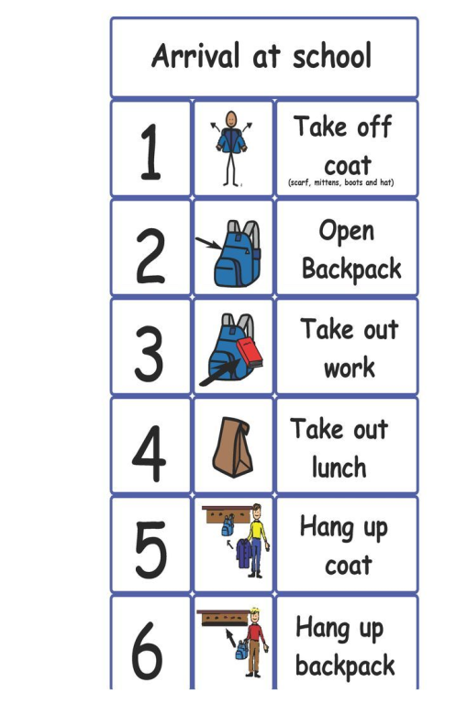
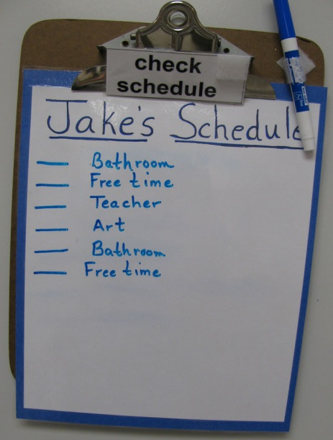
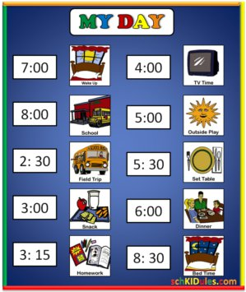
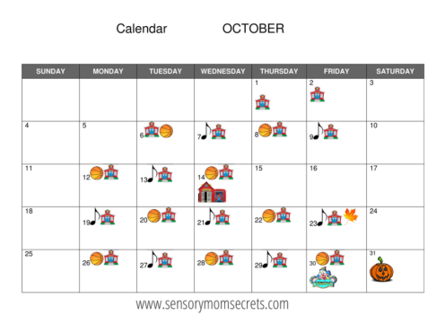
Routine, timetable, agenda

Slide 14
Sensory sensitivities
Autistic children tend to experience sensory information differently.
Some unusual behaviours can be linked to children trying to manage their sensory sensitivities
Pay attention to the environment - adjust
Noise, lighting, busy-ness etc
Some children may need more or less stimulation to help them function at their best
Notes:
Some of the unusual behaviours that can be observed in children with social communication difficulties can often be linked to the children trying to manage their sensory experiences. The world can be a very challenging place to live if you get too much or too little sensory information. Children who have very negative reactions to changes in routine or the introduction of new things may find it difficult to be presented with a range of new sensory information that they were not expecting. Research is telling us that it is not just about children ‘disliking’ sensory information; it is common for over sensory sensitive children to experience normal everyday stimulus as being painful.
https://www.youtube.com/watch?v=K2P4Ed6G3gw Sensory overload – warn people first
Sensory Overload - YouTube
https://www.youtube.com/watch?v=zzf80k5b_EM Temple grandin
Sensory diet
Is it sensory or is it behaviour
Weighted jackets,
Chewy tubes
Sensory box
Temple Grandin quotes and you tube
Donna Williams

Slide 15
Sensory Intervention
Planning:
be aware. Look at the environment to see if it is creating difficulties. Can you change anything?
be creative. Think of some positive sensory experiences.
be prepared. Tell the person about possible sensory stimuli they may experience in different environments.
Strategies:
Movement breaks, deep pressure, chews, move n sit cushions, fiddle toys, suck/ blow activities, soothing actitivies
Notes:
Sight - You could make changes to the environment such reducing fluorescent lighting, providing sunglasses, using blackout curtains, creating a workstation in the classroom - a space or desk with high walls or divides on both sides to block out visual distractions, using blackout curtains
Sound – undersensitive: You could help by using visual supports to back up verbal information. You could ensure that the experiences they enjoy are included in their daily timetable, to ensure this sensory need is met.
Oversensitive: shutting doors and windows to reduce external sounds
preparing the person before going to noisy or crowded places
providing ear plugs and music to listen to
creating a screened workstation in the classroom or office, positioning the person away from doors and windows.
Touch: You could help by:
warning the person if you are about to touch them - always approach them from the front
remembering that a hug may be painful rather than comforting
changing the texture of food (eg purée it)
slowly introducing different textures around the person's mouth, such as a flannel, a toothbrush and some different foods
gradually introducing different textures to touch, eg have a box of materials available
allowing a person to complete activities themselves (eg hair brushing and washing) so that they can do what is comfortable for them
turning clothes inside out so there is no seam, removing any tags or labels
allowing the person to wear clothes they're comfortable in.

Slide 16
Support social understanding and inclusion (1)
Help them recognise, name and learn about their emotions
Emotional literacy programs
Scaling – the Incredible Five Point Scale
Use their special interests – to find safe social opportunities or to help explain things (e.g. what would Iron Man do? What was he thinking?)
Seek supportive, structured social spaces - lunchtime clubs? Library?
Find jobs and tasks to show their skills and help others.
Allow space for a “social break” - downtime

Slide 17
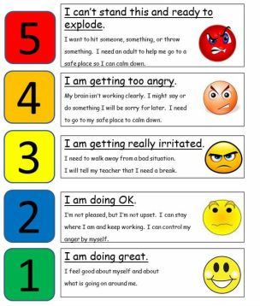
Example of Five Point Scale

Slide 18
Build up their own Emotional Toolbox
Promote coping strategies and abilities in all areas:
Physical
Relaxation
Social
Communication
Thinking
Sensory
Notes:
Look to give them the skills to be able to handle the situations. Promote their abilities in all these areas.
Think about what they should do physically – use physical exercise to increase coping skills
Relaxation skills –
Social – helps to understand social situation and what they can do in these situations . Use social stories
Thinking promote thinking and problem solving skills – use comic book conversations to help their thinking skills by dissecting situations.
Talk through your thinking processes.
Sensory – how do they cope, what changes can we make to the environment, how can they communicate that things are difficult

Slide 19
A reminder
National Autistic Society
www.autism.org.uk
Autism Hampshire
www.autismhampshire.org.uk
Barnados Specialist Parenting Support
Hampshire Specialist Parenting Support Service | Barnardo’s
Ask About Autism – BRAAIN/HPCN
https://www.braain.co.uk/ask-about-autism.
Any questions?
Notes:
Look to give them the skills to be able to handle the situations. Promote their abilities in all these areas.
Think about what they should do physically – use physical exercise to increase coping skills
Relaxation skills –
Social – helps to understand social situation and what they can do in these situations . Use social stories
Thinking promote thinking and problem solving skills – use comic book conversations to help their thinking skills by dissecting situations.
Talk through your thinking processes.
Sensory – how do they cope, what changes can we make to the environment, how can they communicate that things are difficult

